Slide 1

SLIDESHOW PROJECT 5
Use public data from openfoodfacts
From mickael ly

Slide 2

Use public data from openfoodfacts
A french company wants to create an application that helps consumers to change their nutrition.
This program will interact with the Open Food Facts database in order to collect these products and its informations.
The program compares nutrigrade et recommend a more healthy substitute.
If the user likes the substitute, he can save it to his favorite list.

Slide 3
Before starting
Think and interact using Agile methodology
Create a new repository on Github =
➔ https://github.com/Goro-Majima/OpenFoodFacts
Create a virtual environment (.gitignore, requirements.txt)
Set Visual studio code as the main text editor

Slide 4

Installation
Python 3.7
Mysql-connector-python, Requests packages
Mysql server + Workbench

Slide 5

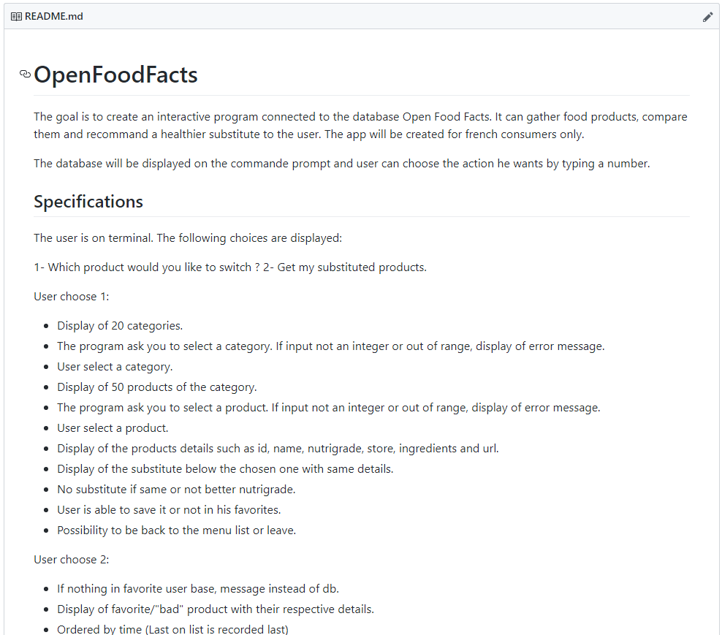
Thinking and interacting
Defining the steps and process of the different functions.
Filling Readme Driven Development.
Managing on Trello for a global and more accurate view of the process.

Slide 6
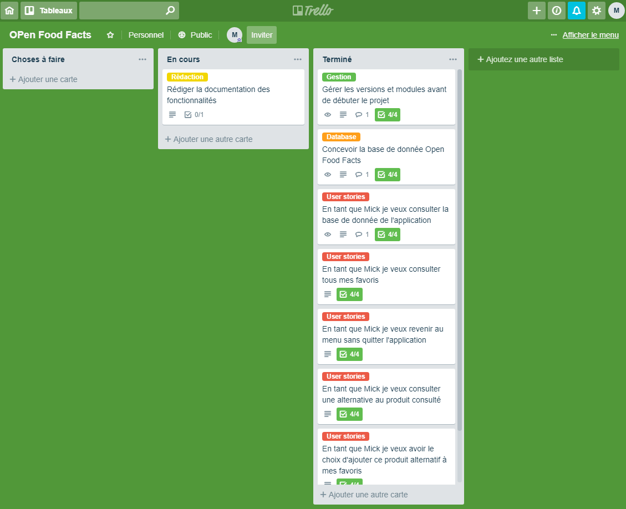
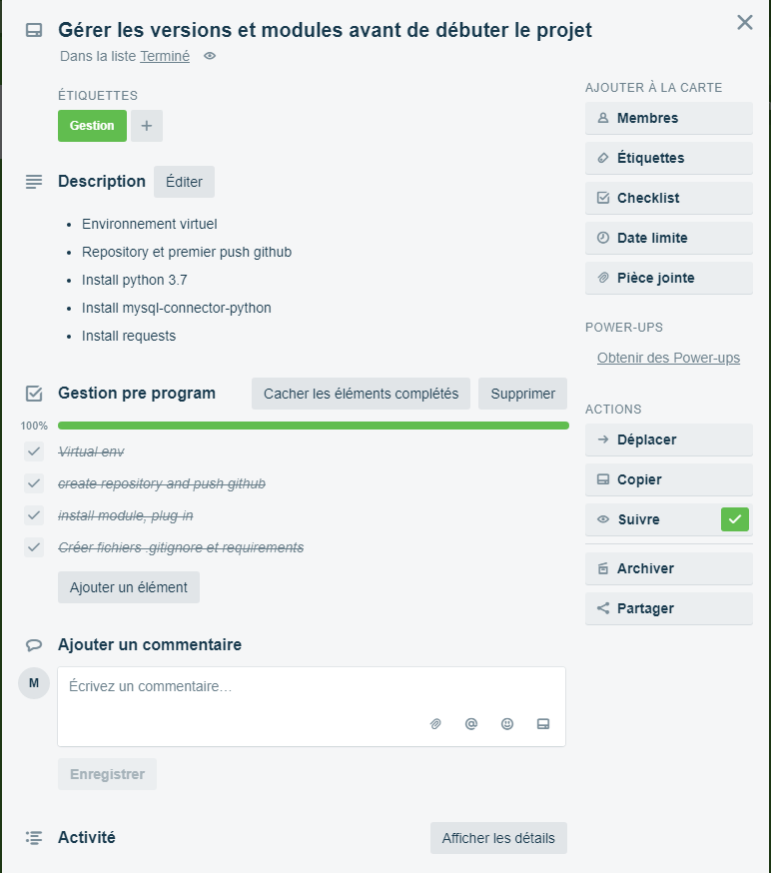
Using trello
Cutting scenarios in several User stories
focus on each User story and define tasks

Slide 7

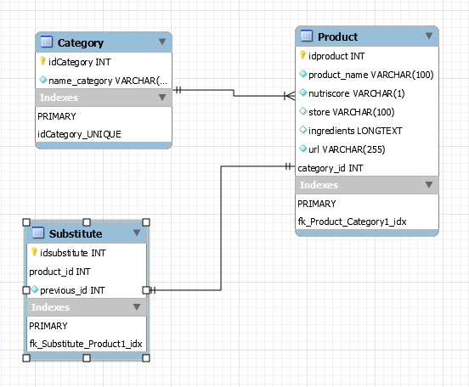
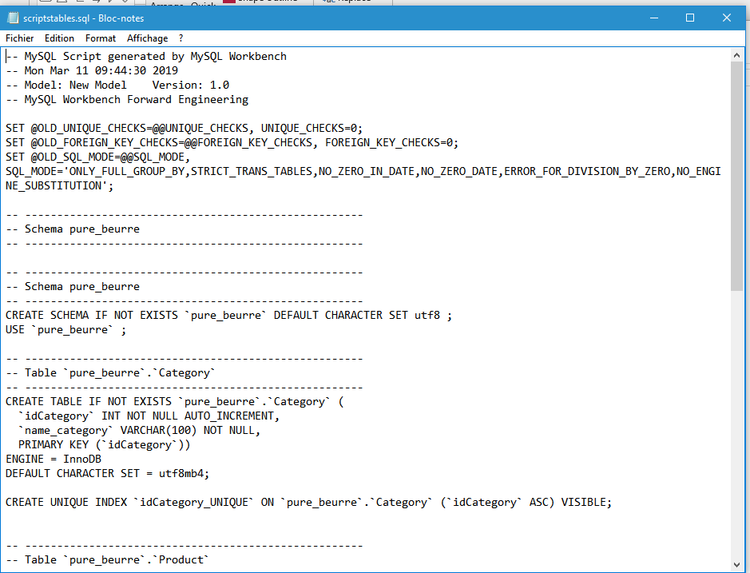
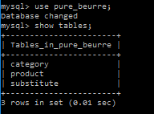
BUILD the database
Define tables, fields and set primary and foreign keys by drawing a physical data model with workbench then use SQL scripts, then checks and tests

Slide 8
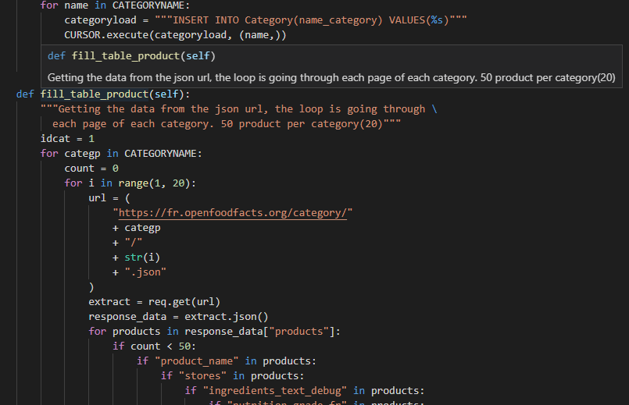
FILL THE DATABASE
EXTRACT OFF DATA FROM API IN JSON FORMAT

Slide 9
Fill the database
Extract Open Food Fact data from API in JSON format.

Slide 10
Customize this Template
Template Editing Instructions and Feedback

